Slide 1
APPLICATION NAME Health Human Resource Interconnector
GROUP VI
(Data Dynamos)
MEMBERS
REX MUDANYA
ZACCHAEUS AMENYA
DORCAS MWILU
OKENDO JACK
WESONGA MUKOYA
COLLINS KARANI

Slide 2
Introduction
iHRIS Manage is a human resources management tool that enables an organization to design and manage a comprehensive human resources strategy.
It helps an organization manage its workforce more effectively and efficiently, while reducing costs and data errors.
The HR professional can create a hierarchy of positions for an organization based on standard titles, job classifications and job descriptions, even spread over diverse geographic locations, offices and facilities

Slide 3
Current Situation
HR Staff is responsible for entering and updating data in the system(IHRIS). Can also view reports, is web based
IPPD captures basic biographical data
It is not web-based and is housed in the Department of HR, former MOM
Request of data from IPPD is time consuming for IPPD staffs/ former MOPHS.

Slide 4
Problem statement
Data on IHRIS is inconsistent with staff return and IPPD data
Both IPPD and IHRIS do not have healthcare workers deployment facility
Data access from IPPD is time consuming
IPPD is built on outdated technology
Lack of interoperability between the two systems
Static, unreliable data that is only accessible to a few individuals
E.g. Discrepancies in Kilifi County health workers payroll

Slide 5
Solution
The proposed platform is an API that enable dynamic data exchange between relevant systems (interoperability)
It will include a database that will collect data on health care workers
It will capture the deployment facility, employment status and expiry of contract for temporary employees.
It will cross-check data from IPPD and IHRIS, identify the differences and verify validity of the data.
Health workers will be able to update personal information individually

Slide 6
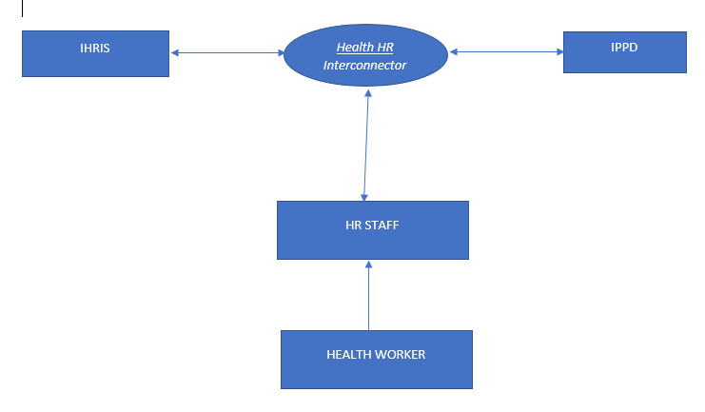
Architectural design

Slide 7
Sustainability and scalability
Sustainability- the amount of money that will be saved as a result of operating the API can in turn be used to maintain it.
Scalability- API technology can be accessed by other platforms and its functionality be extended as per HR data requirements

Slide 8
Existing solution
There are a number of existing systems in the health sector e.g DHIS2, OpenMRS, IPPD
The systems have not yet been able to integrate APIs for dynamic data exchange.
HHRI is therefore, the first API for HR data
Thus the other systems can utilize the API

Slide 9
Expected impact
Reduced department’s annual spending on recurrent expenditure
E.g Kilifi county is now saving KES 1,256,383 per month
The other systems will be able to utilize the API instead of developing their own from scratch

Slide 10
References
IHRIS and Records Management user guide, June 2016 MOH
Article on Intra-Health website, Dec 2017
HRIS-HMIS Interoperability assessment for Kenya Public Health Informatics Institute, July 2013
www.treasury.go.ke/32-departments/it-services/126-system-development
IPPD Initiative, MOPS, Management Consultancy Services Division, 1994

